Slide 1
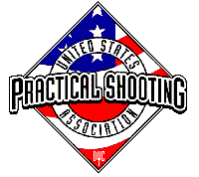
 | 28 Rounds v1
START POSITION: Standing anywhere in the shooting area, facing downrange. Handgun, wrists below belt. PCC, buttstock on belt, weak hand wrist below the belt.
GUN READY CONDITION: Handgun loaded and holstered. PCC loaded with safety on, buttstock on belt. |  | SCORING: Comstock, 28 rounds, 140 points TARGETS: 14 USPSA SCORED HITS: Best 2 per paper START-STOP: Audible - Last shot RULES: USPSA current edition
STAGE PROCEDURE: Upon start signal, engage targets from the shooting area as they become visible.
Shooting Area
Setup Note: (14 target stands) 1) No Shoots in center area should force movement to engage 4 center targets 2) Middle shooting area should be 10 yards from target 3) Long head shots should be 15-20 yards.

